Slide 1

North Texas Region Dana Center Math Pathways
Planning Workshop:
Co-requisite, Advising & Transfer
Issues & Next Steps
June 19, 2017

Slide 2
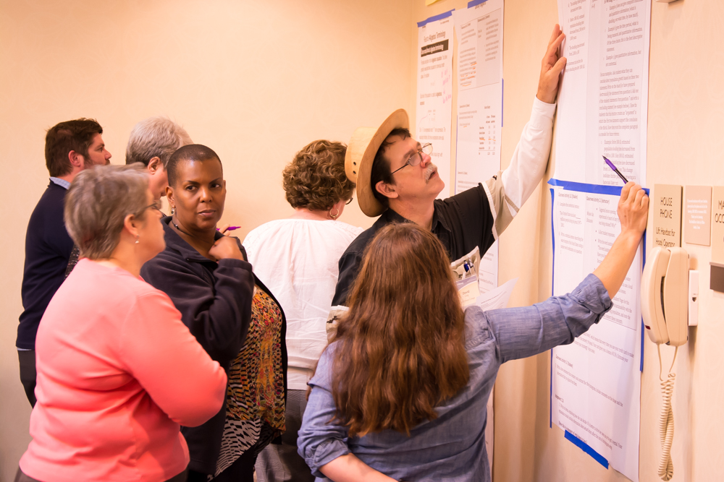
Goals for the Day: What will we accomplish together?
Identify regional successes and issues/challenges in:
  Co-requisite math legislation
  Advising for math pathways
  Math transfer
Plan for capturing & disseminating regional issues and actions in a white paper(s)
Action steps for 2017-8

Slide 3
DCMP Vision
All students have equitable access to and the opportunity for success in rigorous mathematics pathways that are aligned and relevant to their future aspirations, propelling them to upward economic and social mobility.
The DCMP seeks to ensure that ALL students in higher education will be:
Prepared to use mathematical and quantitative reasoning skills in their careers and personal lives,
Enabled to make timely progress towards completion of a certificate or degree, and
Empowered as mathematical learners.
Notes:
Key points (1 min):
DC been woking on equity in ed for over 20 years
FOCUS ON RELEVANCE - Dana Center goal is that all students will have the opportunity to take rigorous, challenging gateway math courses that are relevant to their educational and career goals and to their future lives. Means multiple pathways to and through math department for all students (nnot just math majors)
- “Mathematics is TOO important to be left to mathematicians” - Derek Holton, 2006
“to exercise their responsibility of mathematics, mathematicians must not think primariliy about their own department but about the whole university” (p. 308)

Slide 4
Dana Center Principles for Pathways
Institutions implement structural and policy changes quickly and at scale.
Mathematics pathways are structured so that:
All students, regardless of college readiness, enter directly into mathematics pathways aligned to their programs of study.
Students complete their first college-level math requirement in their first year of college.
4
Notes:
Key points (2 min):
The Dana Center has created a model based on four broad principles.
Coherence without Uniformity: Institutions/local leaders decide how to implement the principles
First two principles related to structural changes.
Regardless of readiness and Aligned to POS – means that students placed into dev ed will experience remedial content most relevant to the college-level course – placement test are largely algebra based, and ASSUME k12 students don’t have exposure to statistics or modelling
Co –requisite emerging as the most promising way of doing this – CCRC – momentum research.
Information for Principle 1 (from the resource site):
States and institutions identify a small number of math pathways to fit the needs of students in various programs. At the state level, the gateway course in each pathway is defined by learning outcomes created by faculty leaders informed by research, recommendations from professional associations and other leaders and practices in other states.
Institutions make unambiguous recommendations for the preferred or default mathematics pathway for categories of programs of study or meta-majors. For example, Quantitative Reasoning might be the default pathway for all liberal arts majors.
The process of selecting the appropriate mathematics pathway is supported by an advising experience that helps students make informed decisions about their career and life goals.
Supports for students who are not college ready are aligned with the gateway math course.
Faculty and administrators engage in cross-institutional efforts with transfer partners to establish consistent and predictable math requirements.
Information for Principle 2 (from resource site):
All students, regardless of college readiness, are required to take math within their first two semesters.
All mathematics pathways that span more than one term use strategies to minimize attrition between terms.
Most students who are not college ready enter directly into college-level courses with adequate supports. Institutions use data to identify students who need additional support, such as a yearlong pathway.

Slide 5
Dana Center Principles for Pathways
Institutions and departments engage in a deliberate and thoughtful process of continuous improvement to ensure high-quality, effective instruction.
Students engage in a high-quality learning experience in math pathways designed so that:
3) Strategies to support students as learners are integrated into courses and are aligned across the institution.
4) Instruction incorporates evidence-based curriculum and pedagogy.
Notes:
Key points (2 min):
Principles 3 and 4 address the quality of the learning experience. – using research about how students learn and experience our institutions
Principle 3 is about both how students are supported within a classroom and how well the strategies within the classroom align with student supports across the institution. We want to create coherence in how we support students as learners. This work is on-going. Always working to improve.
Principle 4 – students are not empty vessels of to be filled with knowledge – they co-create meaning thorugh productive struggle, questions, applications – non-cognitive factors (grit, growth mindset, purpose, belonging, self-efficacy) all affect college outcomes -
Information for Principle 3:
Activities, materials, and pedagogy that help students develop the skills, attitudes, and beliefs necessary to be successful, independent learners enhance mathematics instruction in all courses, especially entry-level courses.
These strategies build upon and align with other institutional student support programs so that students receive consistent and coherent supports across their entire college experience.
Faculty and student support staff have joint “ownership” of the student success agenda. Institutional structures and processes encourage and enhance collaboration.
Information for Principle 4 (from the resource site):

Slide 6
Definition of math pathway
...a mathematics course or sequence of courses that students take to meet the requirements of their program of study.
The concept of math pathways applies to pathways for college-ready and underprepared students.
Notes:
Key points:
Need to establish common terminology.
Even if students only take one course, there is is still a pathway that considers how and from where the student enters the pathway and where the pathway leads in the future.
Integrates with guided pathways – about whole student experience –

Slide 7
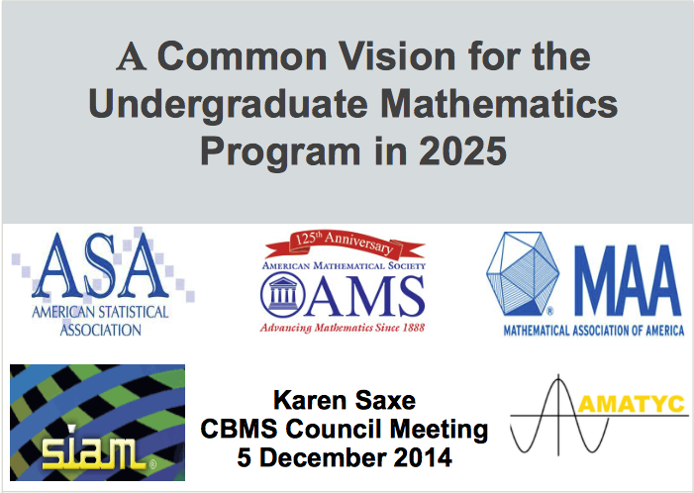
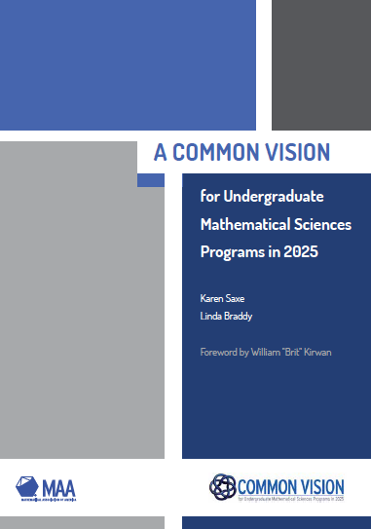
A Common Vision for the Undergraduate Mathematics Program in 2025
The primary goal of this initiative is to develop a shared vision in the mathematical sciences community of the need to modernize the undergraduate mathematics program, especially the first two years.
“The mathematical sciences community must begin to think in terms of a broader range of entry-level courses and pathways…. p.13
the problem of placing students in appropriate entry-level courses.” p.17
Notes:
“[Traditional] placement efforts have focused primarily on accurate placement in mathematics and not in statistics because students entering college rarely had any background in that subject; this is no longer the case”

Slide 8
DCMP State Approach
Bring together faculty, advisors and administrators from 2 & 4 statewide
Early Success: Colo.,Montana, Ohio, Nev.
Identify common vision and goals for math pathways
Share & scale best practice
Develop positive policy and transfer framework
Institution-led implementation across regions or states

Slide 9
Texas: Regional Approach
North Region for Dana Center Math Pathways
6 Texas Regions – Each sets goals for area
North Region: 9 community colleges and corresponding transfer partners
  Identify successes, issues, and actions
  Develop white papers and share across region
  Plan for expansion of discussion and action during 2017-8

Slide 10
Dana Center Principles for Pathways
Quick structural change
Mathematics pathways are structured so that:
    All students, regardless of college readiness, enter directly into mathematics pathways aligned to their programs of study.
    Students complete their first college-level math requirement in their first year of college.
Continuous improvement
Students engage in a high-quality learning experience in math pathways designed so that:
    Strategies to support students as learners are integrated into courses and are aligned across the institution.
    Instruction incorporates evidence-based curriculum and pedagogy.
Notes:
Key points:
- Recap the four principles and highlight any notes that did not get presented during the introduction of

Slide 11
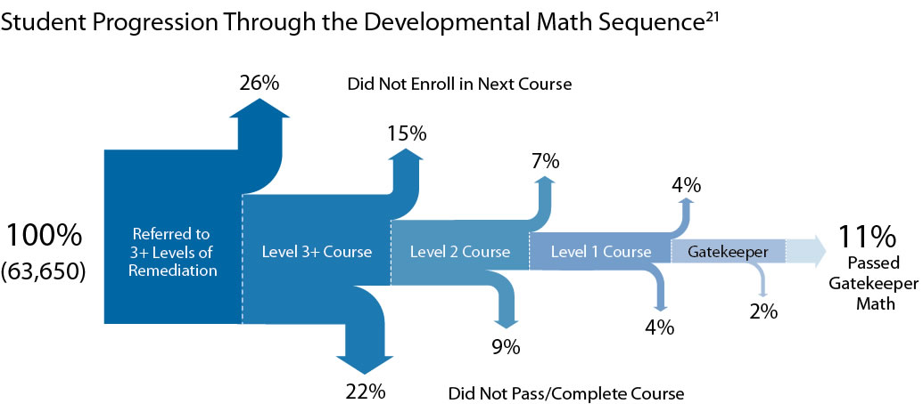
Developmental education attrition
Source: Bailey, Jeong, & Cho, 2010
Notes:
Bailey jeong cho – ATD colleges – national data – understand student patters through dev ed –
- Students are more likely to not enroll in next course, than to fail any individual course (bailey jong cho) and
- BACK to BACK Texas NMP data (college-level completion more than doubles when institutions promote successvie semester enrollment)
Students say - demoralizing , waste time and money, don’t see how it’s connected to their goals.
Time is the enemy – delays progress, 1) more opportunity for something to go wrong…
momentum – CCRC gateway course completion short term indicator that predicts other education outcomes

Slide 12

College Readiness of Incoming Cohorts Decreased in 2015
Source: THECB data, Developmental Education Report

Slide 13
The Right Math for the Right Program

Slide 14
What is the “Right Math”?
Burdman, P. (2015). Degrees of freedom: Diversifying math requirements for college readiness and graduation. Oakland CA: Learning Works and Policy Analysis for California Education.

Slide 15
Many students who begin on an algebra path never reach—or never intend to reach—calculus.
Source: Dunbar, 2005
Source: Dunbar, 2005.
Notes:
Dunbar has tracked all students at the University of Nebraska–Lincoln for more than 16 years and has examined enrollment patterns among about 150,000 students. He found that only about 10% of the students who pass college algebra ever go on to start Calculus I and virtually none ever go on to start Calculus III. He has also found that about 30% of the students from college algebra eventually start business calculus.

Slide 16
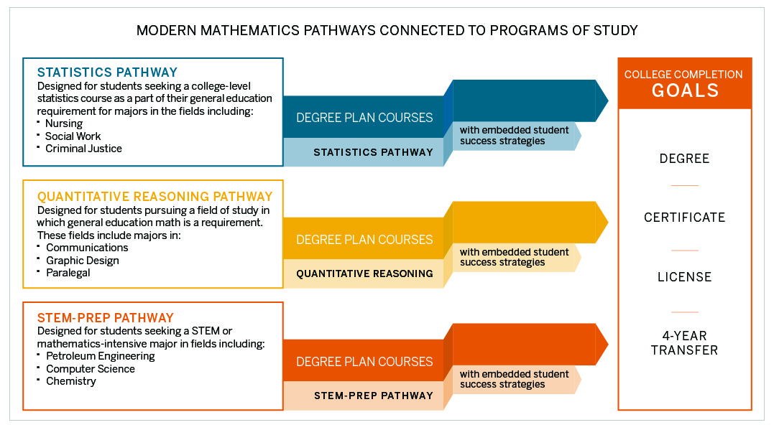
Example Pathways
Notes:
These are example pathways. Work at the state and institution level is ongoing to determine the pathways that make the most sense for their population.
In a few slides, we will show how the pathways that are emerging in Texas are similar to, yet distinct from what may be emerging in other states.

Slide 17
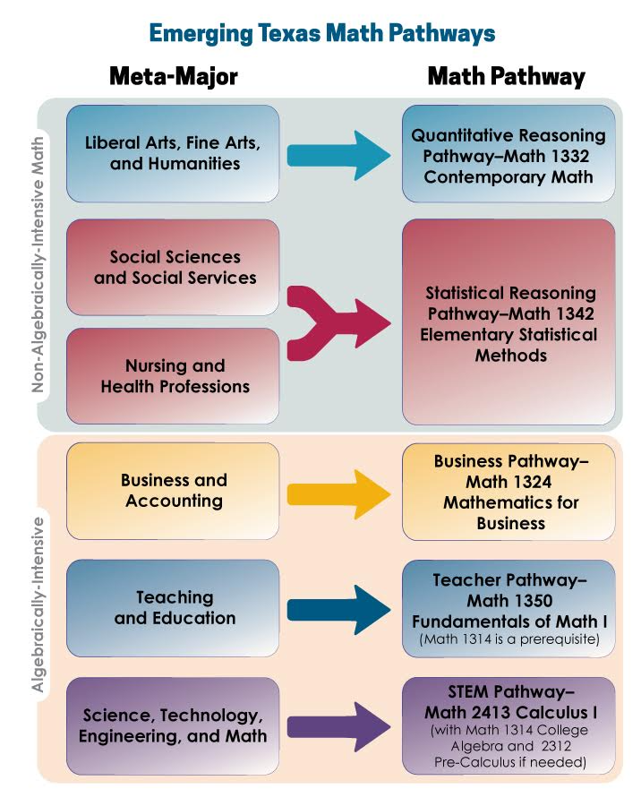
Pathways
Emerging in Texas

Slide 18
Texas Transfer Context
78
149

Slide 19
Texas Transfer Context
78
…the percent of bachelor’s completers that had community college credit on their transcripts. Almost 40% had 30+ SCH.
…the average number of credits accumulated by a bachelor’s degree completer
149
National Student Clearinghouse Research Center. (2012). Transfer and mobility: A national view of pre-degree & student movement in postsecondary institutions. Retrieved from http://nscresearchcenter.org/signaturereport2/#more-1580
Complete&College&America. (2012). Time is the enemy. Washington, DC: Complete College America.

Slide 20
Texas Transfer Context
Highest in U.S. according to National Student Clearinghouse
78
…the percent of bachelor’s completers that had community college credit on their transcripts. Almost 40% had 30+ SCH.
…the average number of credits accumulated by a bachelor’s degree completer
Highest in 36-state sample according to Complete College America
149

Slide 21
Trends Across Texas Universities

Slide 22
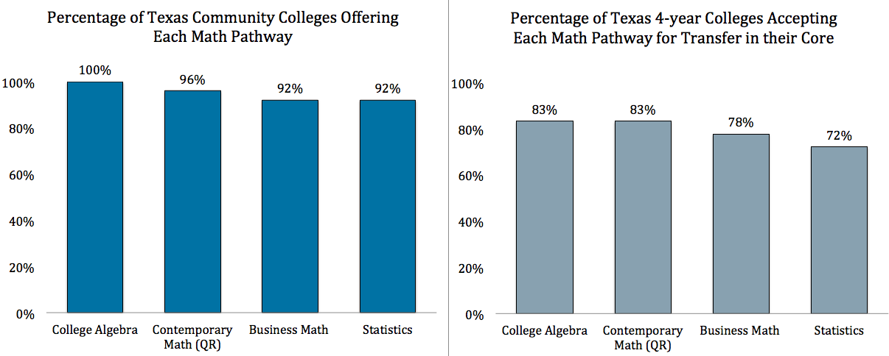
Fall 2016 Texas Math Pathways Offerings
Notes:
In Fall 2016, 100% of Texas two-year colleges are offering 3 or more math pathways. One hundred percent of Texas four-year colleges are offering 2 or more pathways as part of the core curriculum, and 79% are offering 3 or more pathways.

Slide 23
College Level Math Completion in First Year

Slide 24
College Level Math First Year
Placement
Multiple Measures
Acceleration e.g. Co-requisite

Slide 25
Percentage of DE students enrolled in an accelerated option is increasing
Source: THECB Data, CBM00S
Notes:
Notes:
These figures are only for Community and Technical Colleges due to ease of tracking DE courses using ACGM.
Key points:
Percentage of DE students enrolling in an accelerated option is increasing, but still fairly low considering diversity of options (NCBO, coreq, IRW)

Slide 26
Successful first college-level course completion is increasing for underprepared students within 1 year
Source: THECB data, Developmental Education Report
Notes:
Note:
- This slide is just referring to the students who enter underprepared; 16% of underprepared students complete first college-level math course in one year. The figure for those who enter directly into the college-level course is not represented here.

Slide 27
Co-requisite
Does institution offer a corequisite (co-enrollment/mainstreaming) option for each college-level course area?
The majority of institutions report offering a co-requisite DE option
 | Yes | No
Math-intensive course | 73% | 27%
Reading-intensive course | 75% | 25%
Writing-intensive course | 78% | 22%
Source: Source: Developmental Education Program Survey (DEPS) 2016
Notes:
Key Point:
- Don’t let people get too excited about the 73% number. As the following slides will show, just ‘offering’ doesn’t mean that these supports are being broadly offered to students nor does it speak to their success.

Slide 28
Source: Tennessee Board of Regents.
Notes:
Also found a 45% increase in fall-to-fall retention rate for students passing co-requisite – From 47-69%

Slide 29
Focused Discussion & Planning Steps
Group I : Math Faculty Co-requisite
Group II: Advising for Math Pathways
Group III: Transfer & Articulation of Math by Program

Slide 30
Apply today’s outcomes:
Plan for 2017-8
Expand involvement – Fall Regional Convening
Capture best practice, issues and recommendations in “white papers” to share across the region
Focus on action planning rather than presentations
Partner with NTCCC to focus future conferences in support of DCMP
Set goals and plan actions for scale of math pathways

Slide 31
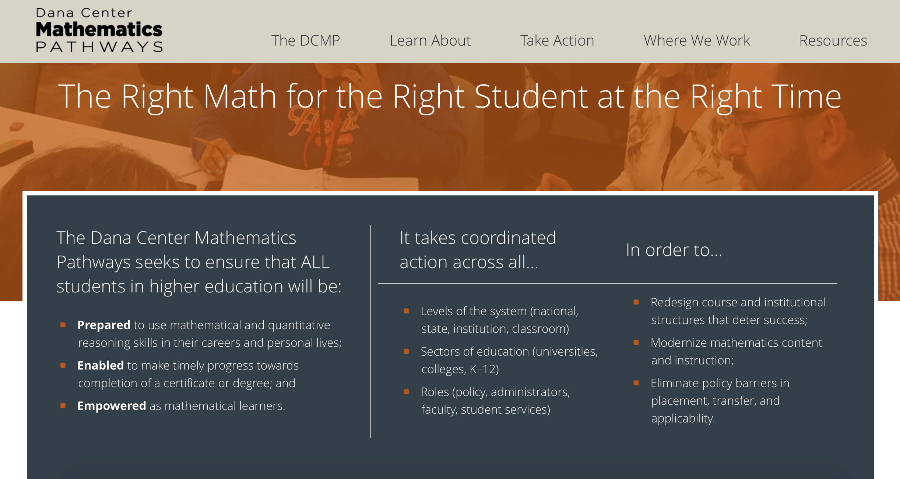
Support your work
Dana Center Mathematics Pathways Resource Site: http://www.dcmathpathways.org/
Notes:
Key points:
If possible, navigate to site and point out features. If not possible, use the screen shots on the following pages to orient people to the site.

Slide 32
Contact information
General information about the Dana Center:
www.utdanacenter.org
Dana Center Mathematics Pathways Resource Site: www.dcmathpathways.org
To receive monthly updates about the DCMP, contact us at: dcmathpathways@austin.utexas.edu
Jeremy Martin (policy): jeremyryanmartin@austin.utexas.edu
Connie Richardson (math courses): cjrichardson@austin.utexas.edu
Nancy Stano (professional learning): nk.stano@austin.utexas.edu

Slide 33
About the Dana Center
The Charles A. Dana Center at The University of Texas at Austin works with our nation’s education systems to ensure that every student leaves school prepared for success in postsecondary education and the contemporary workplace.
Our work, based on research and two decades of experience, focuses on K–16 mathematics and science education with an emphasis on strategies for improving student engagement, motivation, persistence, and achievement.
We develop innovative curricula, tools, protocols, and instructional supports and deliver powerful instructional and leadership development.
2016
Notes:
2 min
Key points:
Director Uri Treisman
Organized research center at the University of Texas at Austin
Work across K-12 and higher ed
Help practitioners put learning from research into action

