Slide 1
Suggested Use
This PowerPoint slide deck provides resources for presentations about the New Mathways Project and math pathways. This slide deck is not meant to be used in its entirety. You are encouraged to select slides based on the purpose of a presentation and its intended audience.
Additional information for the presenter is included in the Notes sections on the slides.
Text in red on the slides provides additional guidance on usage and identifies opportunities for customization throughout the slide deck.
Consider adding state and local data. Some sample slides are included.
The following slide provides a table of contents for this slide deck.

Slide 2
Table of Contents
Slides 3-6: Dana Center slides on the New Mathways Project and Mathematics Pathways to Completion
Slides 7-13: Sample slides for state context
Slides 14-16: National Context: Trends and Thought Leadership
Slides 17-25: National Context: Data on College-Level Math and Completion
Slides 26-30: National Context: Data on Developmental Courses and Impact on Completion
Slides 31-40: Acceleration and Corequisite Models

Slide 3
The Dana Center and New Mathways Project
The New Mathways Project promotes math pathways based on four principles.
1
Multiple pathways aligned to specific fields of study
2
Acceleration that allows most students to complete a college-level math course in one year or less
3
Intentional use of strategies to help students develop skills as learners
4
Curriculum design and pedagogy based on proven practice
Notes:
These four principles, referred to as the NMP Model, are the foundation of all of the Dana Center’s work with math pathways. The NMP model sets out a broad vision of pathways without dictating specific strategies or structures. This allows leaders at different levels of the system to define their own vision within the NMP model.
The Dana Center supports work through all levels of the system (state, institutional, classroom) to support implementation of the principles. At each level, the Dana Center helps mobilize and support local leadership to determine how the principles will be customized to the local needs and context. At the state level, faculty leaders and policy representatives collaborate to establish a vision for math pathways within their state. At the institutional and classroom levels, local leaders determine how they will implement the pathways.

Slide 4
The New Mathways Project: What and How
NMP Goal: Dramatically increase student success and completion in higher education
Objective: Establish mathematics pathways as the normative practice for how students complete their mathematics requirement
NMP Essentials
Set broad principles that allow for local customization
Work throughout the system: state, institutional, classroom
Empower and mobilize local leaders
Promote broad engagement across systems

Slide 5
State-Level Work Under the New Mathways Project
Fifteen states have engaged in state-level work with the Dana Center through multiple initiatives.
Partnership with Texas Association of Community Colleges
Building Math Pathways to Programs of Study
Mathematics Pathways to Completion
Work with individual states
Notes:
At the state level, faculty leaders and policy representatives collaborate to establish a vision for math pathways within their state and to create a positive environment that enables colleges and universities to implement pathways. This includes addressing potential obstacles such as policies on placement and transfer.

Slide 6
The MPC Process
A process to move from state-level mobilization to institutional implementation.
Phase I: Build urgency and intrinsic motivation for change
Phase II: Enable scale by creating the policy and practice conditions for statewide implementation
Phase III: Enact the NMP at institutions by building faculty and institutional capacity
Consulting, tools, and services support each phase. Each state creates a customized plan and timeline.
Notes:
The Dana Center launched the Mathematics Pathways to Completion (MPC) in late 2015 to work with five states to implement math pathways. The five states are Arkansas, Michigan, Missouri, Oklahoma, and Washington. It is a three-year project based on a process with three phases.
Phase I: Math task force sets vision and makes recommendations for math pathways, identifies obstacles that need to be addressed. This results in a published set of recommendations.
Phase II: (short transition phase): Task force creates and enacts a plan to address the obstacles and create support for institutions to implement math pathways.
Phase III: Individual institutions create and enact local plans to implement the task force recommendations. Regional and state work continues to promote and support the work.
Each state works with a dedicated consultant to support the process. The Dana Center provides resources such as planning tools, models and exemplars, and specialized consulting with content experts.

Slide 7
Sample Slides for State Context

Slide 8
An Introduction to the New Mathways Project
An initiative of the Charles A. Dana Center at The University of Texas at Austin
[Insert state name and/or the name of your task force here]
Notes:
Title slide for presentation

Slide 9
What topics should the task force address?
Common issues among math task forces
What math pathways are needed to serve different programs? What courses make up each pathway?
How do students enter the pathways? What are implications for placement, advising, and supports for students who are not college ready?
Do math courses reliably transfer and apply to programs of study?
How do the pathways align to K–12?
Notes:
Use this slide as a discussion starter, if needed. It should be used to elicit and broaden ideas, not dictate topics that the task force should address. It is important that the task force set its own agenda.

Slide 10
State Context: What should I know about what’s going on in our state?

Slide 11
State Context: Data on Students’ Progress to and Through Postsecondary Mathematics
Data [Options listed below. Add or delete based on your needs and constraints.]
Rate of referral to developmental education: [%]
Rate of success in developmental mathematics: [%]
Rate of success in gateway mathematics courses: [%]
Completion rate: [%]

Slide 12
State Context: Goals and Priorities
State aims [customize]
Example: The state seeks assistance from mathematics faculty to lead and develop an improvement agenda.
3 priority areas
Increase success in mathematics
Increase degree completion
Improve alignment and transferability of credits

Slide 13
State Context: Other Projects or Initiatives
Add information about other things happening in the state:
Projects/initiatives that will have an impact on or be impacted by the task force work
Changes in state policy

Slide 14
National Context: Trends and Thought leadership

Slide 15
Why is it the “right time” for math pathways?
Prioritization in the national mathematics community
Structural forces in K–12 education
Completion agenda
Development of structured programs of study
Sweeping dev ed policy reforms
Notes:
Five drivers are creating momentum for math pathways at the national, state, and local levels:
1) Prioritization in the national mathematics community: There is a renewed interest in tailoring the quantitative preparation of students to their fields of study. Leaders of the major professional associations of mathematics are collectively and intentionally focusing their energy on underprepared students and success of students of all majors in mathematics, not just math majors.
2) Development of structured programs of study: New research indicates that students benefit from more structured experiences in higher education in which students are supported to choose a program of study early, and courses in that program are clearly laid out and coherently offered.
3) Sweeping dev ed policy reforms: States such as Connecticut and Florida have enacted policies that significantly reshape developmental education offerings. Even more significant than the final results of those policies (to accelerate, minimize enrollment in dev ed, or make dev ed optional) is the willingness of legislatures to govern course-level policy, typically considered the province of institutions, and more specifically, faculty.
4) Completion agenda: Shift the focus on outcomes instead of inputs in higher education by:
Foundations
Legislatures
Policy organizations
5) Structural forces in K–12 education: Includes changes in standards such as the common core state standards. States that are not adopting the common core (e.g., Texas) are experiencing significant changes in K–12 education that have implications for secondary and postsecondary curriculum alignment. We are also seeing a bifurcation in HS math outcomes (i.e., many graduates are being highly prepared, with more students than ever taking calculus in HS, even as a much larger number of students are leaving HS underprepared for college math).

Slide 16
Mathematics Education in the Spotlight
High-profile reports point to:
Increasing importance of the mathematical sciences to society and the workforce
High failure rates in mathematics are a primary barrier to college completion
Source: National Research Council, 2013; President’s Council of Advisors on Science and Technology, 2012.
Notes:
High-profile reports, such as the Presidential Council for the Advancement of Science and Technology’s “Engage to Excel” and the National Research Council’s “The Mathematical Sciences in 2025,” point to the increasing importance of the mathematical sciences to society and the workforce as well as evidence showing that high failure rates in mathematics are a primary barrier to college completion.

Slide 17
National Context: Data on College-Level Math and Completion

Slide 18
In terms of employability and debt repayment, completion matters for all students.
In 2009, 36% of all beginning college students had not completed a degree or certificate within six years of enrolling.
46% of students who started in public two-year colleges did not complete a degree.
Non-completers borrowed more on a per-credit basis and had lower employment rates than completers across all institution sectors studied.
Source: Chang Wei & Horn, 2013; U.S. Department of Education, National Center for Education Statistics, 2009.
Notes:
This is just one piece in a growing mountain of evidence that postsecondary access alone is not enough to meaningfully accelerate students’ upward mobility.

Slide 19
What indicators are researchers and practitioners considering when addressing barriers to completion?
Among 2003–2004 first-time college students, the percentage of college-level math credits that were attempted but not earned ranged from 38% in two-year colleges to 46% in four-year colleges.
A study of the Virginia community college system found that almost three-quarters of students were not passing gatekeeper algebra courses.
Source: Jenkins, Jaggars, Roksa, Zeidenberg, & Cho, 2009; U.S. Department of Education, 2012.
Notes:
Completion of a credit-bearing gateway math course enables students to progress toward their degree, license, or certificate.

Slide 20
Large numbers of students enroll in developmental education, but many fail to progress.
Among first-time postsecondary students in 2003–2004, 62% of those in associate’s degree and 27% in bachelor’s degree programs took a remedial math course.
70% of students placed into remediation fail to enroll in a gateway math course in two academic years.
Source: Complete College America, 2012 U.S. Department of Education, 2009.
Notes:
Developmental education was designed to help underprepared students gain the skills they need for college success, but there is growing evidence that students referred to dev ed are more likely to end up with debt rather than with a degree.
Half of all undergraduates and 70 percent of community college students take at least one developmental education course. (Judith Scott Clayton and Olga Rodriguez. “Development, Discouragement, or Diversion? New Evidence on the Effects of College Remediation.” NBER Working Paper No. 18328. August, 2012.)
CCA found that 51.7% of those entering a two-year college and 19.9% of those entering a four-year college enrolled in remediation.

Slide 21
Some point out that most students’ majors do not require Calculus—so why are most students placed in course sequences intended to prepare them for Calculus?
Traditionally, students have been funneled into a one-size-fits-all algebra course sequence (starting at the developmental level) designed to prepare students for Calculus, which is necessary in STEM fields, but not in others.
Source: Burdman, 2015; Chen & Soldner, 2013.
Notes:
For students entering postsecondary education in 2003–2004, just 20% of associate’s degree and about 28% of bachelor’s degree students entered a STEM field. Students in social science, liberal arts, and fine arts would be better served by more relevant preparation in statistics or quantitative reasoning.

Slide 22
Many students who begin on an algebra path never reach—or never intend to reach—calculus.
Source: Dunbar, 2005.
Notes:
Dunbar has tracked all students at the University of Nebraska–Lincoln for more than 16 years and has examined enrollment patterns among about 150,000 students. He found that only about 10% of the students who pass college algebra ever go on to start Calculus I and virtually none ever go on to start Calculus III.

Slide 23
Many students who begin on an algebra path never reach—or never intend to reach—calculus. (cont.)
Source: Dunbar, 2005.
Notes:
Dunbar has tracked all students at the University of Nebraska–Lincoln for more than 16 years and has examined enrollment patterns among about 150,000 students. He found that only about 10% of the students who pass college algebra ever go on to start Calculus I and virtually none ever go on to start Calculus III. He has also found that about 30% of the students from college algebra eventually start business calculus.

Slide 24
Many students who begin on an algebra path never reach—or never intend to reach—calculus. (cont.)
Virtually no students who pass college algebra ever start Calculus III, which is a key course for STEM majors.
Source: Dunbar, 2005.
Notes:
These data suggest dual problems in the traditional math, algebraic-intensive sequences—they lower student success and completion and they do not adequately prepare students for the quantitative needs of most fields of study or for the skills needed as citizens of a data-based society.

Slide 25
Recommendations from the Math Community
“Unfortunately, there is often a serious mismatch between the original rationale for a college algebra requirement and the actual needs of students who take the course. A critically important task for mathematics sciences departments at institutions with college algebra requirements is to clarify the rationale for requirements, determine the needs of students, and ensure that department’s courses are aligned with these findings.”
Source: Mathematical Association of America. 2004. Page 27 in Undergraduate Programs and Courses in the Mathematical Sciences: CUPM Curriculum Guide 2004.
Notes:
In other words, professional associations of mathematicians have released statements and curriculum guides that imply and/or directly state that failure can be attributed—in part—to misalignment of developmental and college-level course content with students’ intended academic and career goals. Institutions should offer multiple pathways with relevant and challenging math content aligned to specific fields of study.
http://www.maa.org/sites/default/files/pdf/CUPM/cupm2004.pdf

Slide 26
National Context: Data on Developmental Courses and Impact on Completion

Slide 27
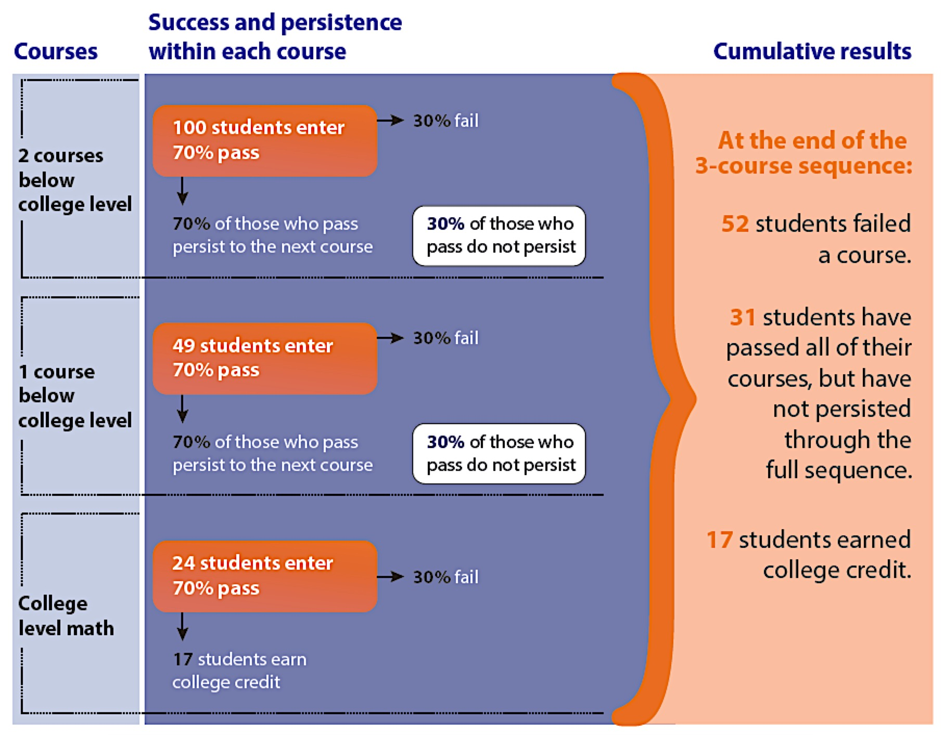
Student completion rates in college-level math drop with each additional level of remedial coursework required.
Demonstrating the effect of multi-course sequences
Source: The Charles A. Dana Center, The University of Texas at Austin, 2015.
Notes:
This theoretical model shows the progression of students through a three-course sequence, assuming success and persistence rates of 70% in each course. Persistence rate refers to the percentage of students who pass and enroll in the next course. As you can see, only 17% of students will successfully complete a three-course sequence, even with relatively high success and persistence rates of 70%. Thirty-one percent pass every course but do not complete the sequence, and 52% fail a course. While this model is theoretical, national data closely mirrors this progression.
One might dismiss the 52% as those students who were unable to master the content, but most faculty members will point out that a significant proportion of students fail a course due to financial difficulties or family obligations such as loss of child care, family illness, or moving for a new job. Long course sequences compound these problems. It is likely that fewer students would fail if the course sequences were shorter.
One study found that only 33 percent of students complete the sequence in math, indicating that math is one of the biggest barriers to college completion in the U.S. (Thomas Bailey, Dong Wook Jeong, and Sung-Woo Cho, “Referral, Enrollment, and Completion in Developmental Education Sequences in Community Colleges,” Economics of Education Review 29 (March 2012); 255–27)

Slide 28
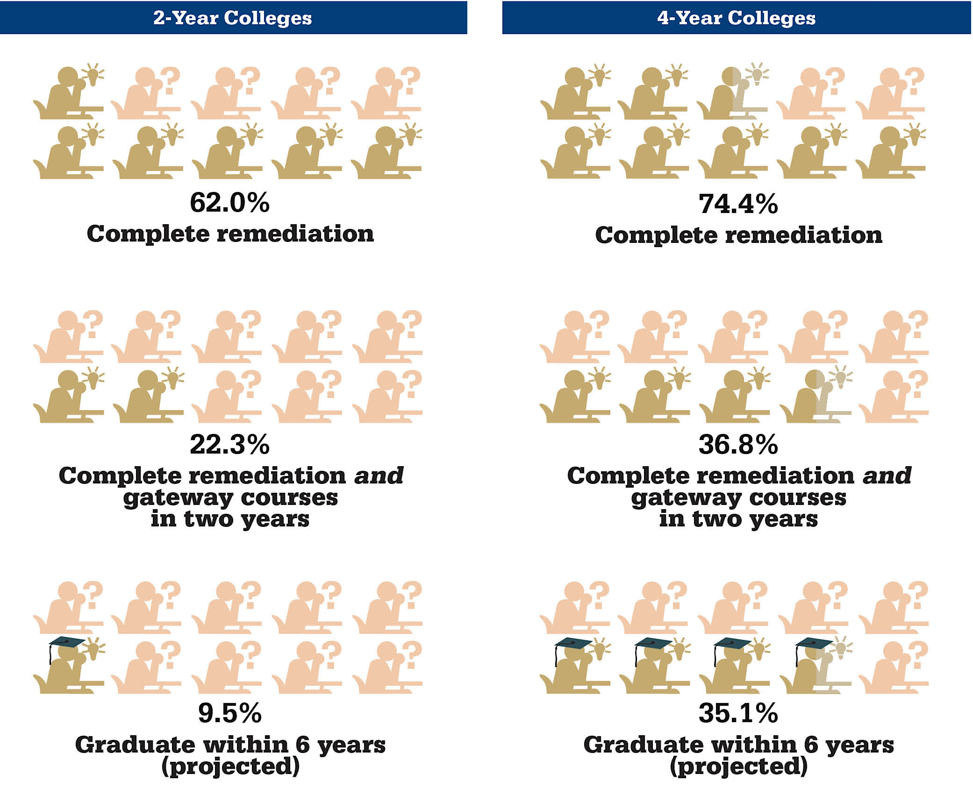
Studies suggest that students taking developmental courses have poor college completion rates.
Source: Complete College America, 2012.
Notes:
A 2006 study by Attewell and colleagues, using data from the 1988 National Educational Longitudinal Study, showed that among students taking at least one remedial course, only 28% went on to complete a college credential within 8.5 years (Attewell, Lavin, Domina, & Levey, 2006).

Slide 29
Recommendations from the Math Community in Georgia
“We recommend that many more students be advised to begin their programs of study in college-level, credit-bearing gateway courses. Underprepared students should also study college-level material with integrated, just-in-time support either in a single semester or over one year.”
Source: University System of Georgia Mathematics Task Force. 2013. Page 5 in Transforming College Mathematics.
Notes:
http://www.utdanacenter.org/wp-content/uploads/USG_Transforming_Remediation_Mathematics_Final_Report.pdf

Slide 30
Recommendations from the Postsecondary Education Community
Source: Core Principles for Transforming Remediation within A Comprehensive Student Success Strategy - A Joint Statement, 2015.
Notes:
Institutions should offer accelerated pathways with integrated support that allow students to complete a college-level math course in one year.

Slide 31
Acceleration and Corequisite Models

Slide 32
Acceleration and Corequisite Models
In corequisite models, students who are not college ready engage with college-level mathematics content immediately with appropriate supports. The support takes a variety of forms in different programs.
Notes:
Slide 1 of 2
There is promising evidence that corequisite models help students who are not college-ready successfully complete gateway math courses more quickly than traditional sequences. Most of these models combine two of the NMP principles: acceleration and alignment to programs of study.
These two slides define corequisite models. The slides that follow provide data from various projects. Please note that this is a broad overview and each program has differences in structure and design. We present this data to show that there is strong and broad evidence for the efficacy of these models. The data should not be used to compare programs. This requires a more in depth analysis of each program and data set.

Slide 33
Two Types of Corequisite Models
One-Semester Model
Students enter directly into a college-level course. Additional support is often provided through a second corequisite course that provides just-in-time instruction.
Year-Long Model
Students take two courses in consecutive semesters. The first course is often defined “developmental,” but the content is redesigned to address topics traditionally reserved for college-level courses. This model is often used for students who are two or more levels below college ready.
Notes:
Slide 2 of 2
There is promising evidence that corequisite models help students who are not college ready to successfully complete gateway math courses more quickly than traditional sequences. Most of these models combine two of the NMP principles: acceleration and alignment to programs of study.
These two slides define corequisite models. The slides that follow provide data from various projects. Caution: This broad overview is intended to demonstrate that there is strong and broad evidence for the efficacy of these models. The data should not be used to compare programs. Each program has differences in structure and design. Any comparison across projects requires a more in-depth analysis of each program and data set.

Slide 34
Math Pathways
Algebra/Calculus Prep Pathway
English Composition Pathway
MATH 135, 136, 137
ENGL 111
English Composition
Tech Pathway
QR Pathway
MATH 100 Intermediate Algebra
ENGL 095
Integrated Reading & Writing
MATH 122 Applied Technical Mathematics
MATH 123 Quantitative Reasoning
FOUN 071
Tech Foundations
MATH 080
Mathematics Principles with Algebra
MATH 023 Essentials of Algebra
Students who wish to change to the Algebra/Calculus Prep pathway must retest. Self study options will be made available for any student who wishes to prepare and retest without enrolling in a course.
Page 2
Notes:
Slide 1 of 2: Ivy Tech
Ivy Tech is the statewide community college system in Indiana. Ivy Tech implemented pathways with a one-semester corequisite model in 2014. In this model, Quantitative Reasoning is the default math course, and only students with declared majors requiring calculus go into the algebra pathway. The tech pathway is for certificate programs.
Students who are not college ready in the QR pathway take Math 080 and Math 123 concurrently. There is no placement below Math 080.

Slide 35
In the past, for every 100 students attempting Math remediation…
100
49
36
29
Attempted remedial math
Completed remedial math
Attempted gateway math
Completed gateway math
Leave Pipeline:
51
13
7
2009 ATD cohort
Time lapse: 1 to 3 years
In Fall 2014 co-req. model expansion, for every 100 students attempting Math remediation…
Fall 2014: 691 students enrolled in MATH 080/123.
Spring 2015: 2,019 students enrolled in MATH 080/123.
100
64
Leave Pipeline:
Attempted remedial & gateway math
Completed gateway math
36
Time lapse: 1 semester
Notes:
Slide 2 of 2: Ivy Tech
Results of Ivy Tech’s corequisite course.

Slide 36
Completion of Gateway Math by ACT Sub-score Community College Pre-requisite Model vs. Co-requisite Pilots
Notes:
Slide 1 of 2: Tennessee
Data from TN Board of Regents on one-semester corequisite model.

Slide 37
Completion of Gateway Math by ACT Sub-score University Co-requisite Model vs. Community College Co-requisite Pilots
Notes:
Slide 2 of 2: Tennessee
Data from TN Board of Regents on one-semester corequisite model.

Slide 38
One-Year Corequisite: Results from Statway™
Success in gateway math within one academic year
Fifty-one percent of all Statway students successfully completed the full pathway (had a grade of C or higher in the final term) and earned college credit for statistics in 2011–2012.
Only 5.9% of non-Statway developmental mathematics students received credit for college-level mathematics in one year.
Source: Yamada, 2014.
Notes:
(Yamada, 2014).

Slide 39
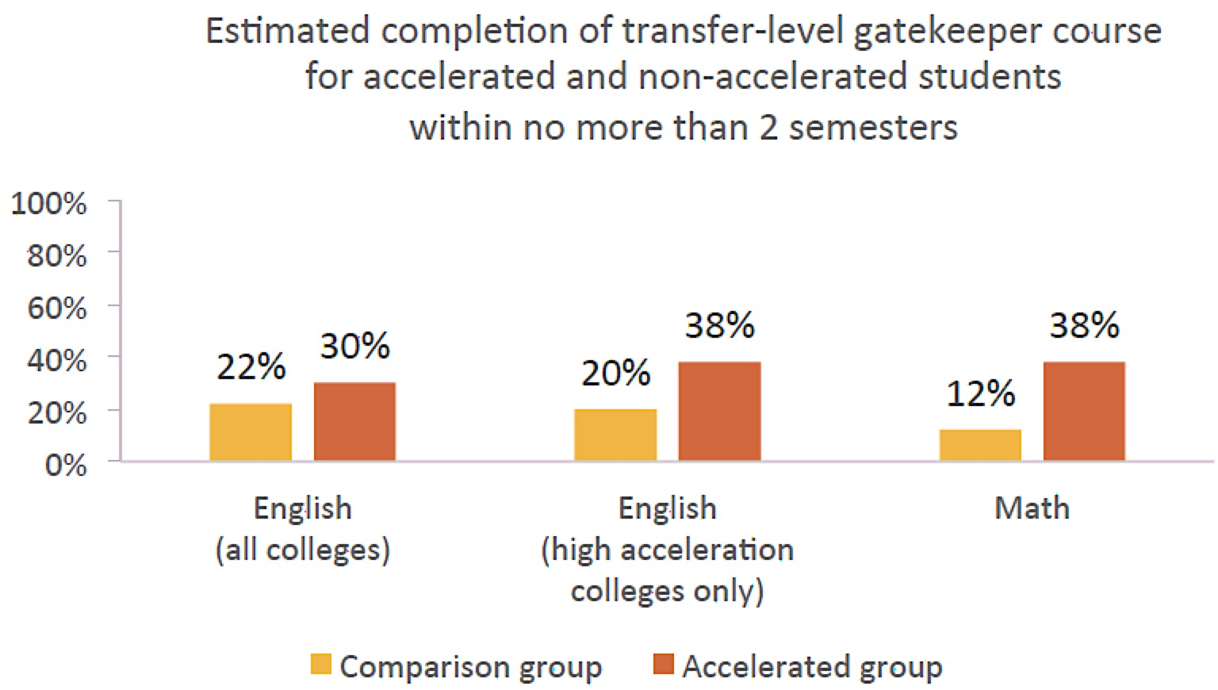
One-Year Corequisite: Results from the California Acceleration Project
Students in accelerated math pathways had 4.5 greater odds of completing a college-level math course than students in traditional sequences.
Source: Hayward & Willett, 2014.

Slide 40
One-Year Corequisite: Results from the New Mathways Project
Three times as many NMP students complete a gateway course in one year, compared to traditional sequences.
For students enrolling in developmental education courses: |  | All FTIC, Community College Students (THECB Data)
 | AY 2013 |  | AY 2014
Developmental Education Completion | 24% in one year n=32,624 |  | 64% in one semester n=1,306
Gateway Course Completion | 8% in one year |  | 23% in one year
Gateway Course Completion: Subset of Colleges using Back to Back Math* | n/a |  | 43% in one year
*Back-to-back math is an evidence-based strategy in which students are encouraged to enroll in a college-level math course in the semester immediately following the completion of their developmental coursework.
Source: The Charles A. Dana Center, The University of Texas at Austin, 2015.
4
Notes:
Success is even higher among institutions effectively using promising practices for back-to-back math enrollment.

